Slide 1
Watson Discovery
Allows for the rapid ingestion, normalization, enrichment, indexing and searching of your structured + unstructured data to enhance various cognitive applications.

Slide 2
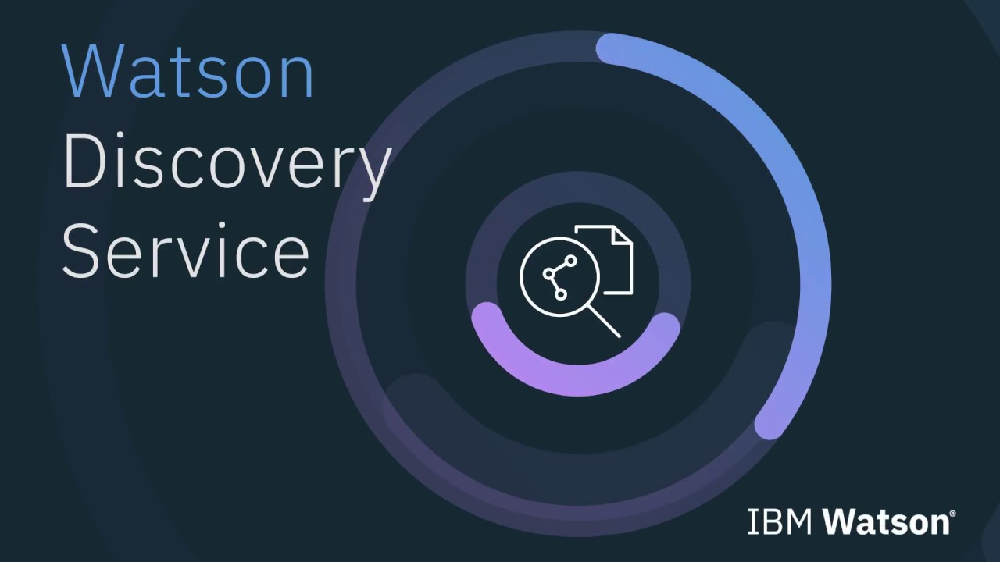
The Watson Discovery Service utilizes natural language processing to extract relevant entities, context, trends, and connections from your data.
Discovery is often used as the backbone of other analytics or AI-enabled applications such as smarter chatbots or NLP-assisted social media monitoring.
In this tutorial, we’ll explore a relevantly simple application of discovery. We will use discovery’s NLP capabilities to better understand a dataset of tweets @Apple and explore the IBM provided Watson Discovery News Dataset.
Watson Discovery Service - Overview

Slide 3
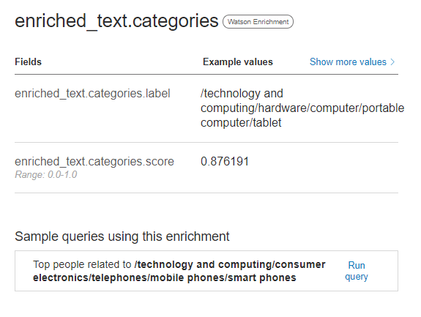
What Does Watson Discovery Do?
Watson Discovery allows us to add NLP-assisted enrichment of inputted text and generate connections between ideas in your dataset. Discovery extracts the following from your data with no explicit training or program.
Entities (big ideas like people, organizations, corporations, etc.)
Sentiments (categorized into a label of positive, neutral, and negative and a range of 1 to -1)
Concepts (secondary idea within your data, may or may not be directly related to your entities)
Categories (derivate through Watson, typically related to products, industries, or tangible items within your data. Broken down into sub-categorizes).
Example: /technology and computing/hardware/computer/portable/tablet (category == tablet)

Slide 4
Difference between Entities, Concepts, and Keywords
Hopefully, you have an understanding of how categories are different from the other elements in the Discovery results. To illustrate the differences between entities, concepts, and keywords, consider the following statement:
“text” : “The shareholder were pleased that XYZ Inc. plants to build a new factory in Toronto, Ontario.”
Entity extraction would return the following:
“type”: “City”
“text”: “Toronto”
“type”: “Company”
“text”: “XYZ Inc”
“type”: “StateOrCounty”
“text”: “Ontairo”
Concept tagging would return the following:
"text": “XYZ Inc."
"text": "factory“
Note: for a larger body of text, Watson would be able to tag concept which were not explicitly stated. For example,
“text”: “iPhone”
“text”: “technology”
Keyword extraction would return the following:
"text": “XYZ Inc"
"text": "new factory"
"text": "stockholders“
"text": “Toronto"
"text": “Ontairo"

Slide 5
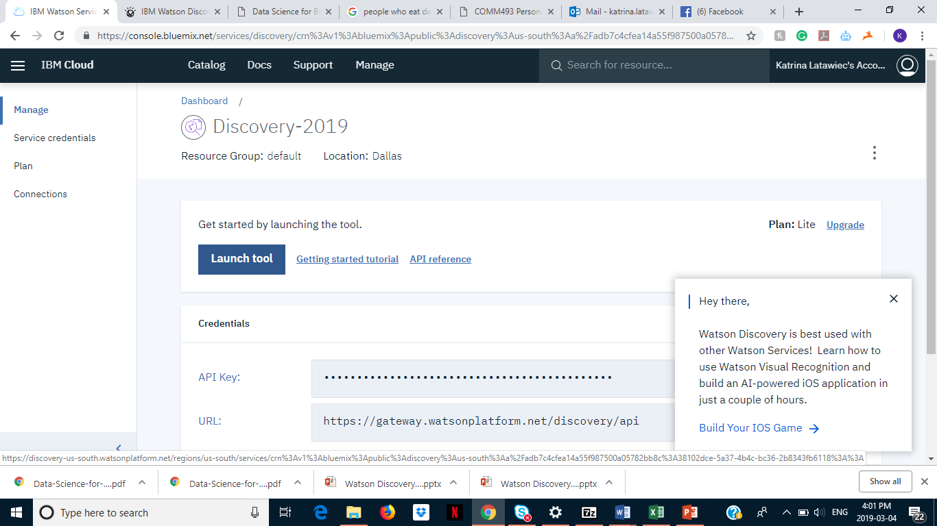
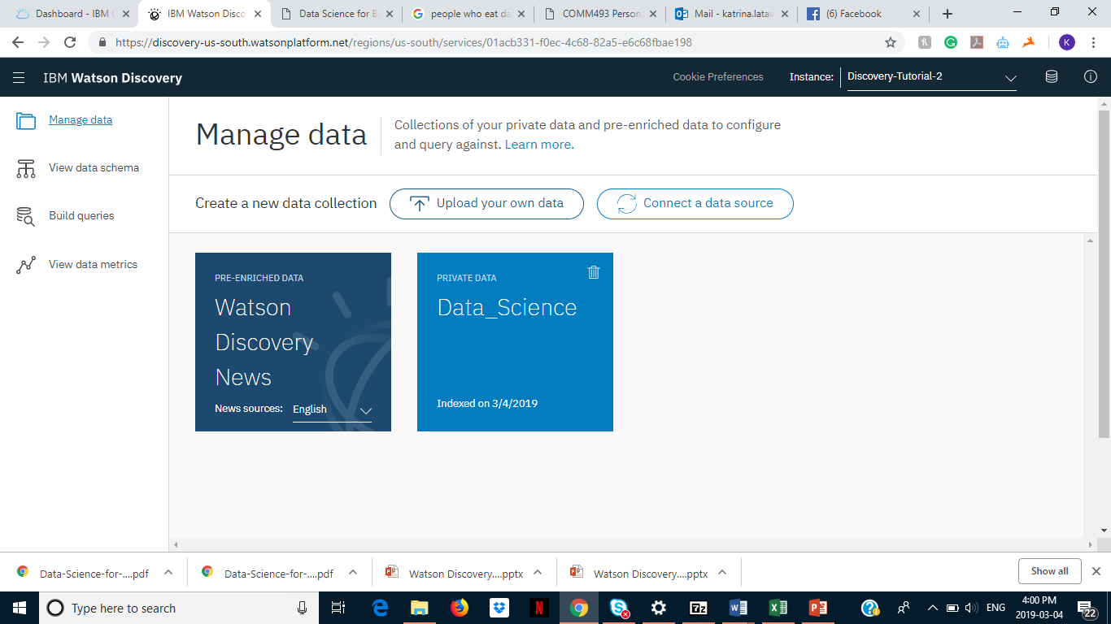
Setting Up Discovery Services
To get started with Discovery, we navigate to bluemix.net’s Watson’s page and click on the Discovery icon.
Once we have done this, we are going to launch the discovery tool (similarly to conversation) to upload our data and set up queries.
This is done through clicking on the create a data collection button in the Watson Discovery interface.

Slide 6
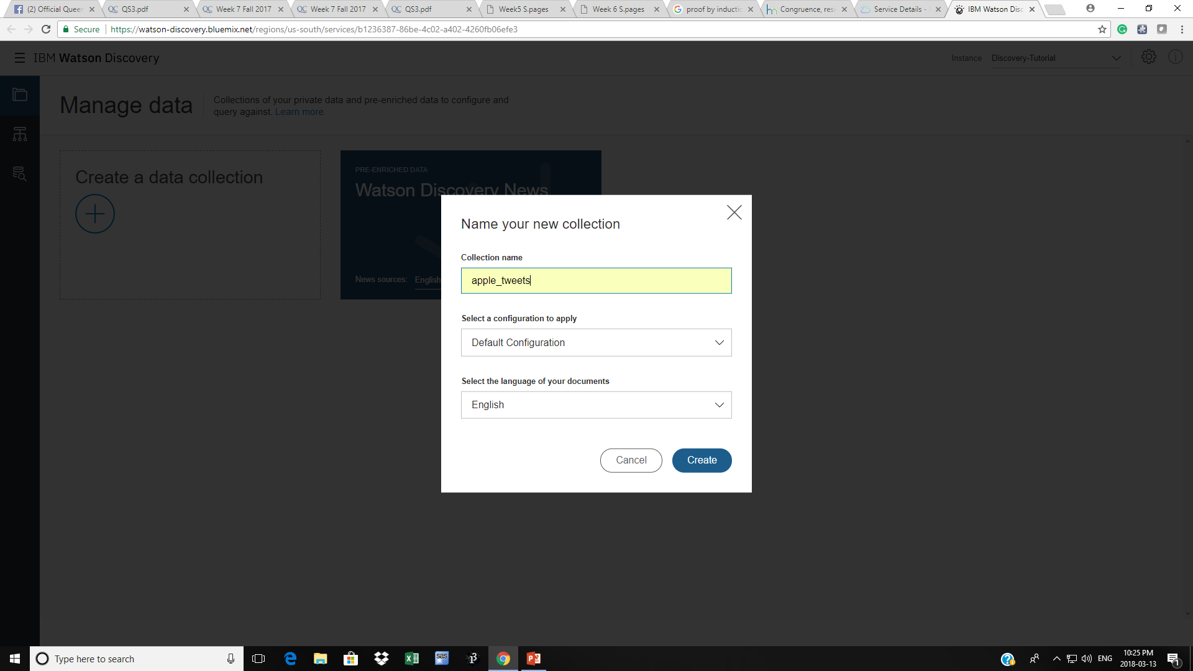
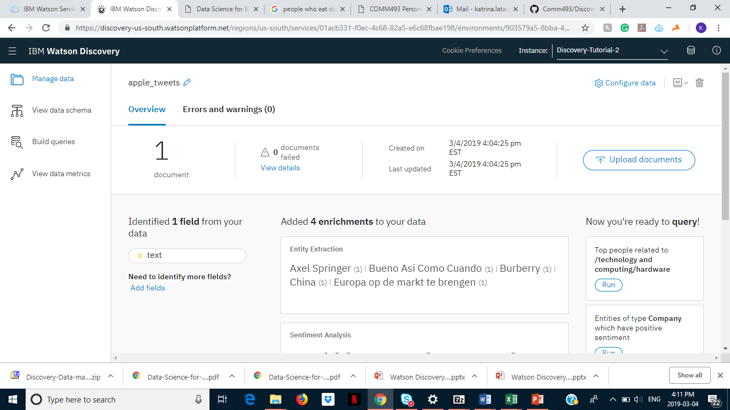
Uploading Data
We will be uploading a sample of roughly 100 tweets from @apple. These will be posted on our GitHub account.
Please download them here: Next, create a new collection with the default configuration settings.
https://github.com/comm-493/Discovery_Tutorial
Next, drag and drop your files into the collection to begin analysis.
Keep in mind, for your projects, discovery can be linked to various APIs or other data sources (SQL databases, salesforce..etc). While it’s a bit too complex for this tutorial, it is a useful feature of the tool.
https://console.bluemix.net/docs/services/discovery/data-crawler.html

Slide 7
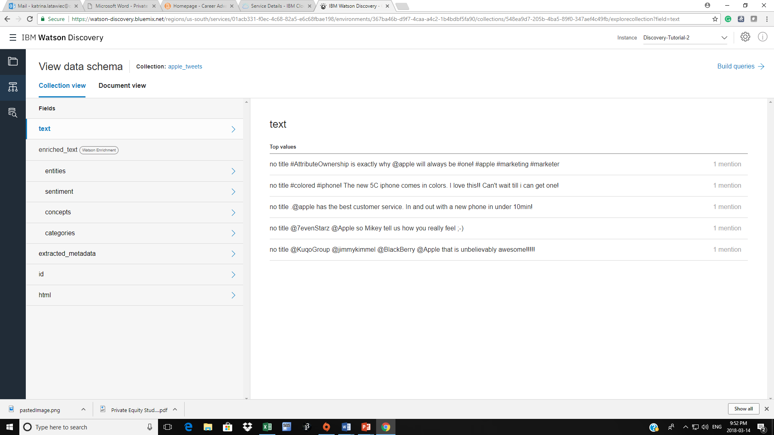
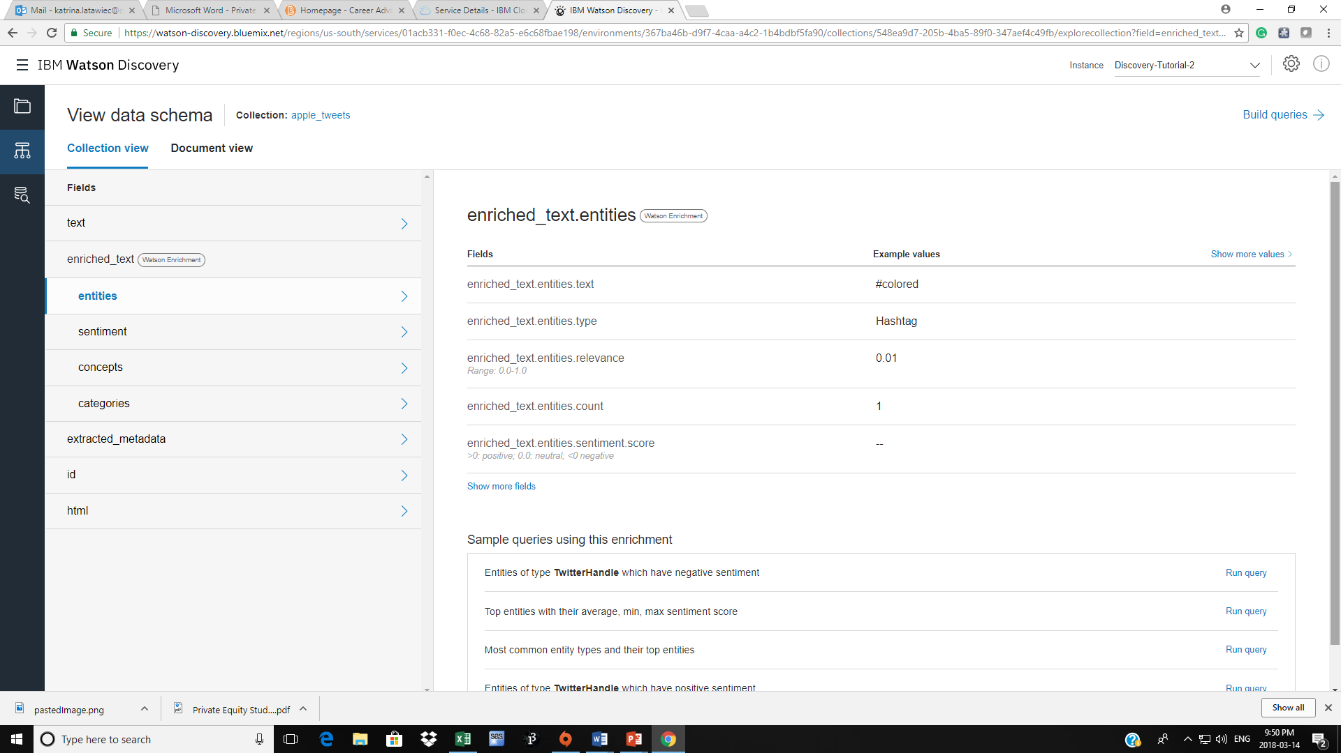
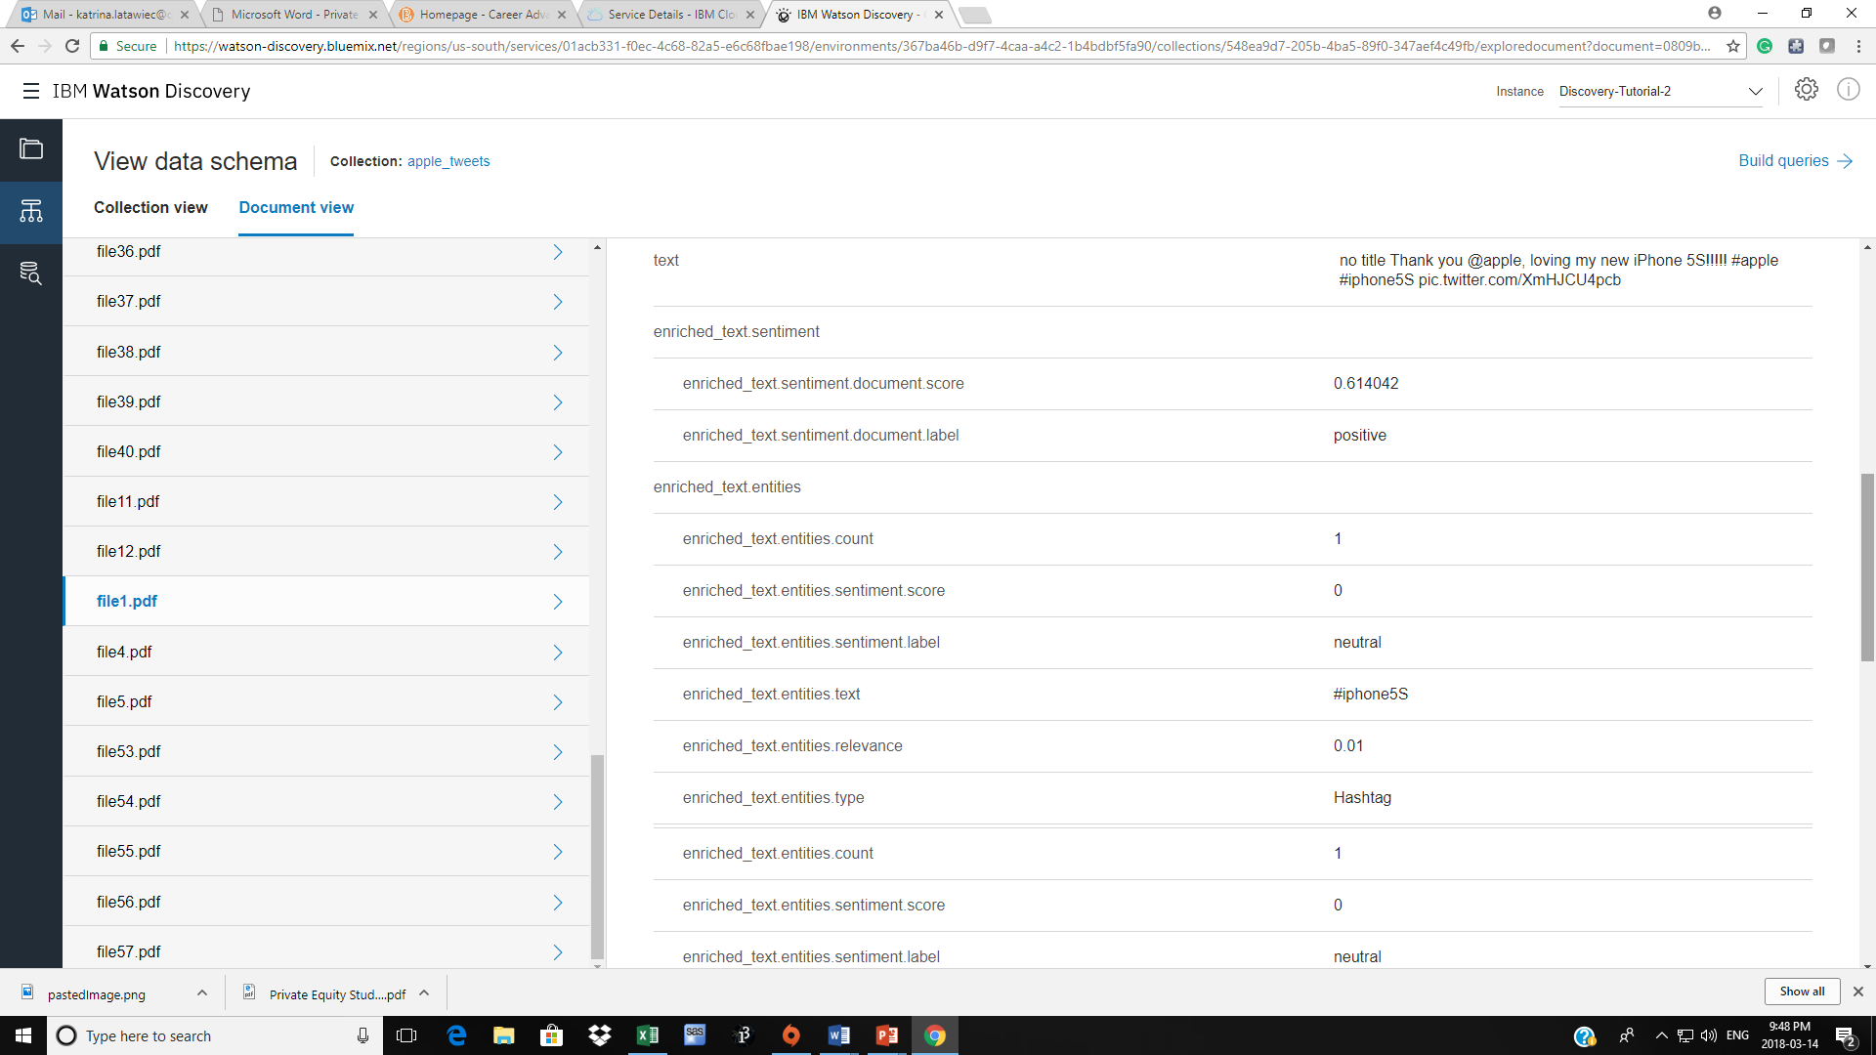
Document and Collection View
Now that we have successfully uploaded, let’s explore our data. Discover has two views which can be accessed through the data structure depicted to the right. The first image is of collection view. This allows you to view your whole collection of documents at a glance. Take a look at what entities, concepts, and categories Watson took from your data.
Below is document view, this allows you to drill down into individual documents in your collection. For example, below an example of file1.pdf’s enrichments.
Collection View
Document View

Slide 8
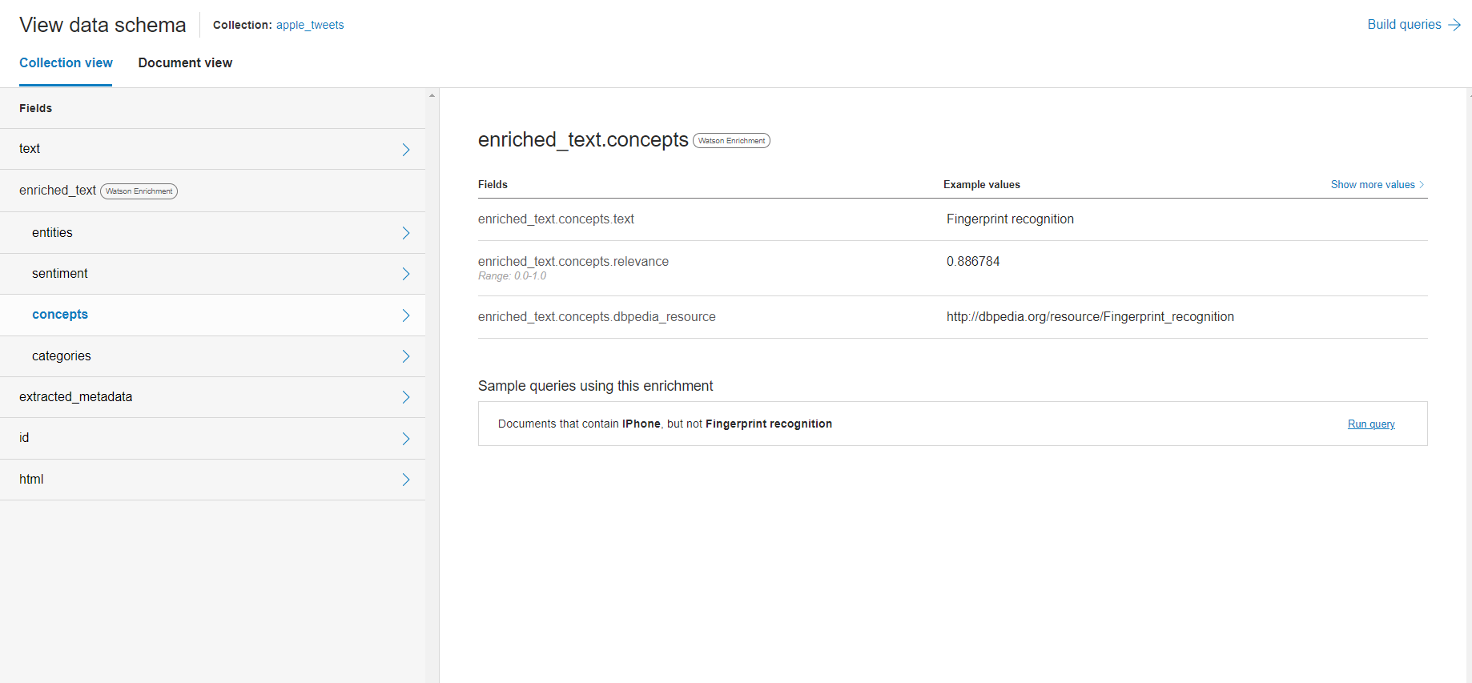
Concepts and Collection View
If we go back to the Collection view page and click on concepts, we can see that Discovery has used its own NLP-assisted methodologies to extract concepts from our documents. Above, it has found the fingerprint recognition concepts which is linked to the iPhone entity. Discover uses dbpedia.org (an online crowd-source machine readable database) to “understand” the concept. In the next slide, you will see a sample query related to the concept. Click it to begin learning about queries in natural language.

Slide 9
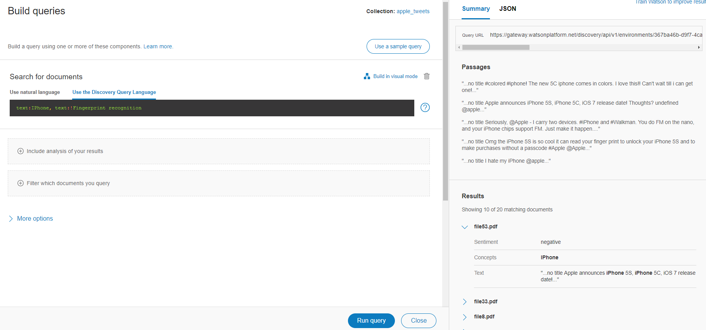
Introduction to Queries
For those of you familiar with database scripting languages like SQL, this is Discovery’s own Query Language and it shares similarities to SQL (even python, in its =! Assignment). However, we will first be looking at natural language queries.

Slide 10
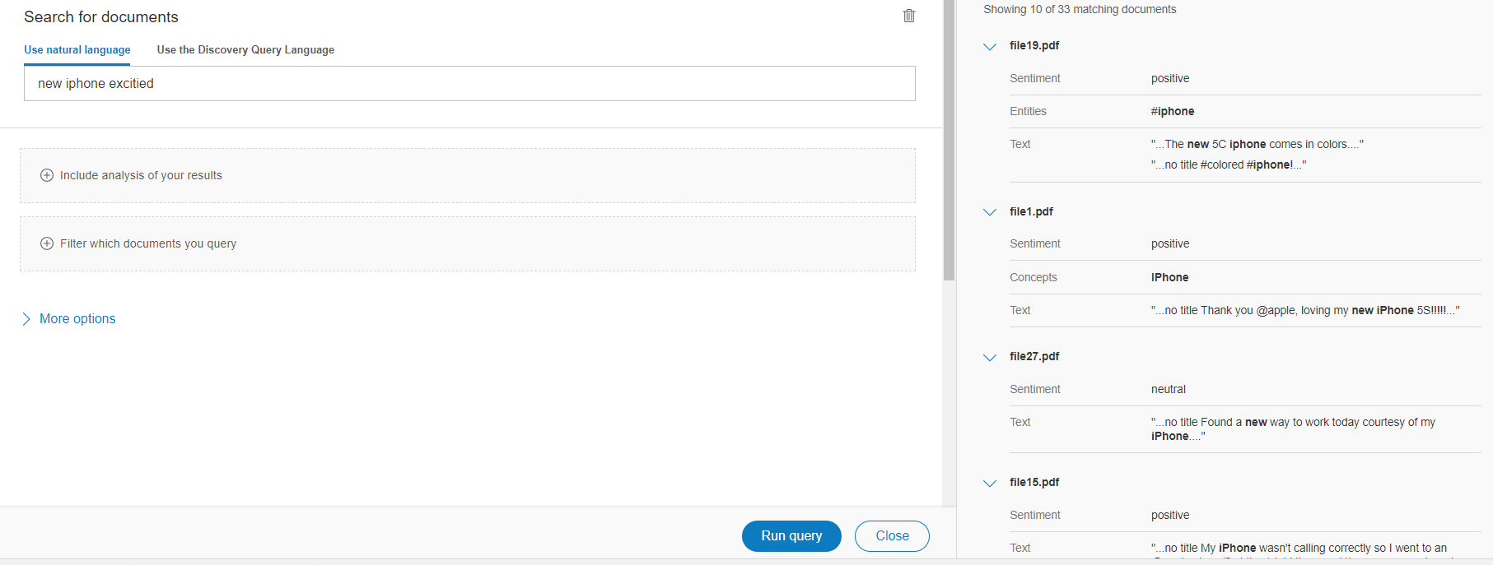
Natural Language Queries
How let’s run a very simple query for a fairly predictable result. If we run the words “new iPhone excited”, we get back the tweets which mention the iPhone as either concept or entity (or hashtag) and ranked highly in terms of sentiment.

Slide 11
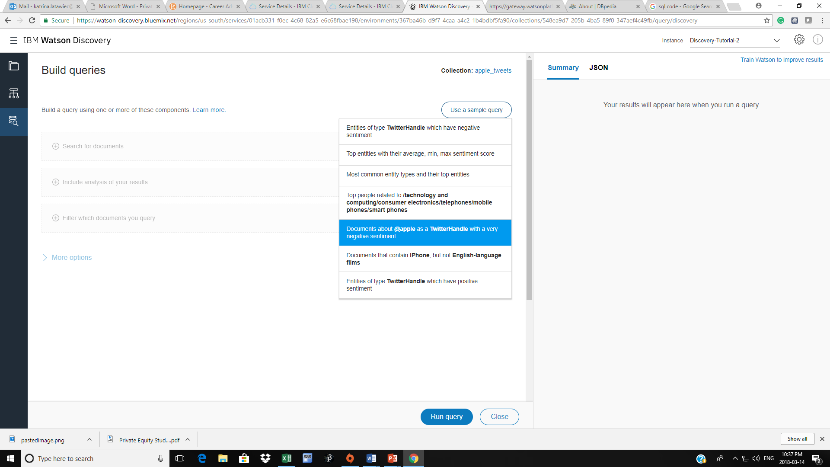
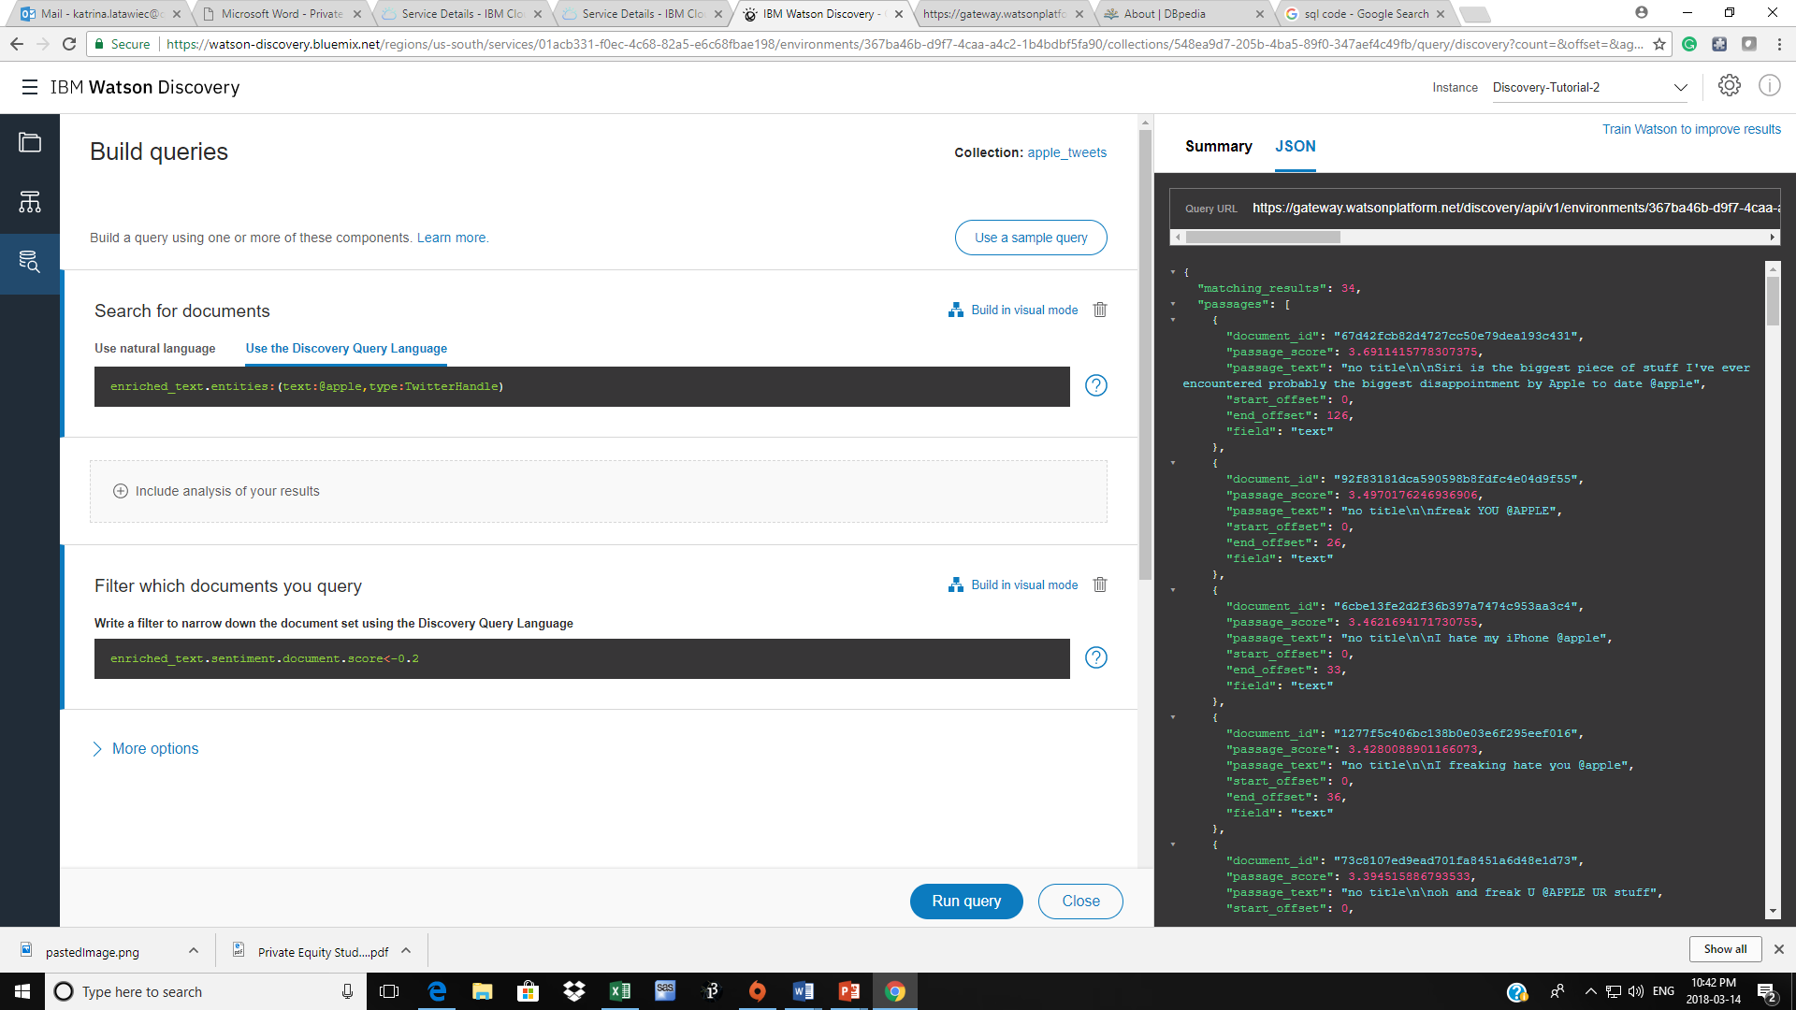
Smart-ish Sample Queries
Watson Discovery also allows the user to choice from a pre-made sample queries based on your data. Above is a query of very negative tweets with the TwitterHandle @apple and the resulting JSON analysis.

Slide 12
Deliverable A:
Now, let’s explore Watson Discovery Query requests using Natural Language.
Generate a query which finds the tweets with the most negative sentiment about the iPhone 5s (but not the 5c).
(yes, it’s a 2014 dataset). Use a negative sentiment score of under or equal to 0.2.
Screenshot your results and save to a Word document.

Slide 13
Watson News Discovery

Slide 14
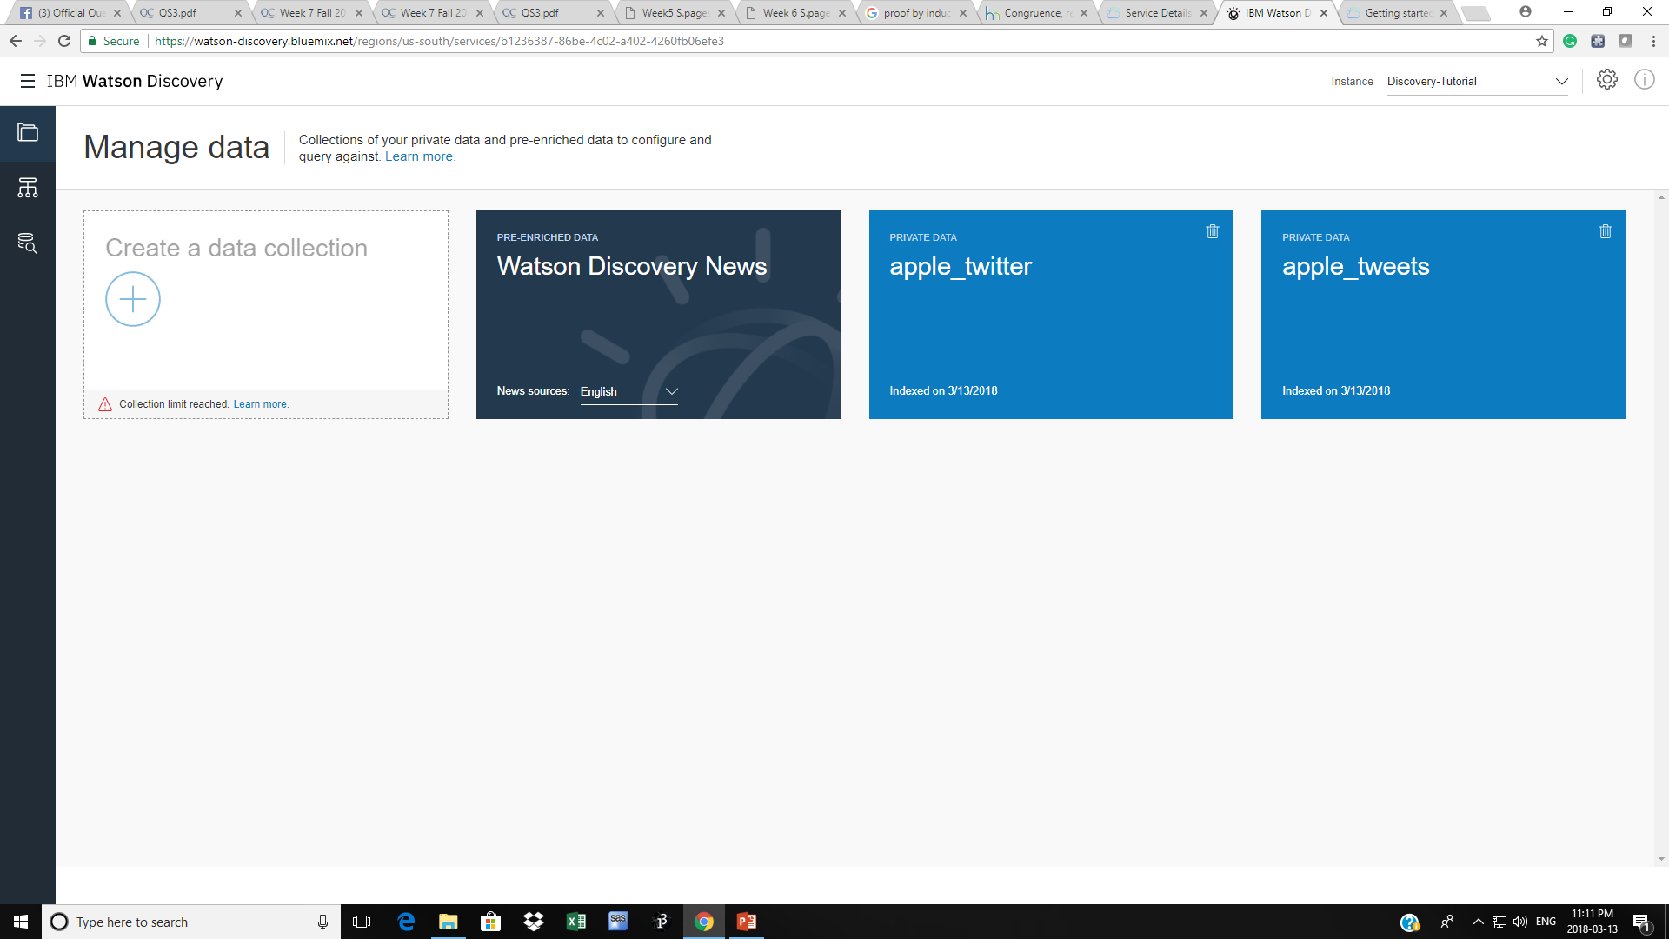
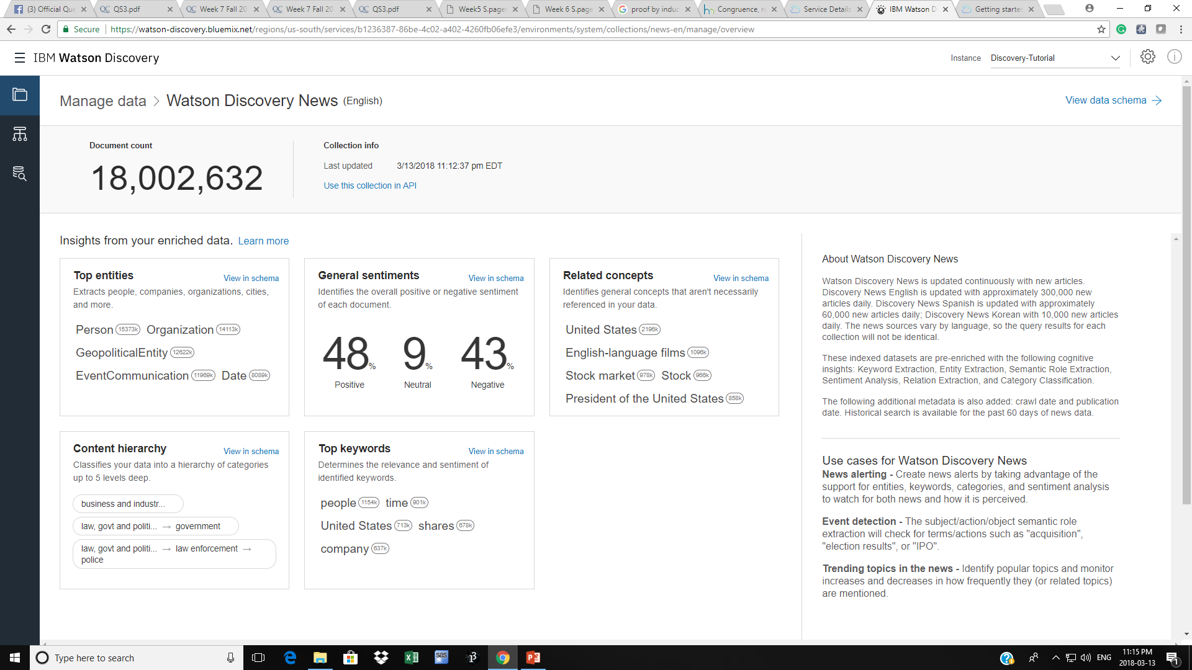
Querying with Discover and Watson Discover News
Now that we have seen how to upload your own data and do queries in natural language, we will focus on learning query with a larger dataset.
Watson Discover News is an active database roughly 16-18 million recent news articles (found online). It is updated with 300k new articles a day and the documents are kept for 60 days. This allows us to query about recent events with a much larger sample size and continually relevant information.
To enter Watson Discover, return to the main page of Discover and click on the icon which says Watson Discovery News (highlighted in red, to the left).
You should see the homepage of Watson Discovery News. This page gives you an overview of their sample.
Next, head to the query page as we will look into Watson’s visual interface for selecting and segmenting data.

Slide 15
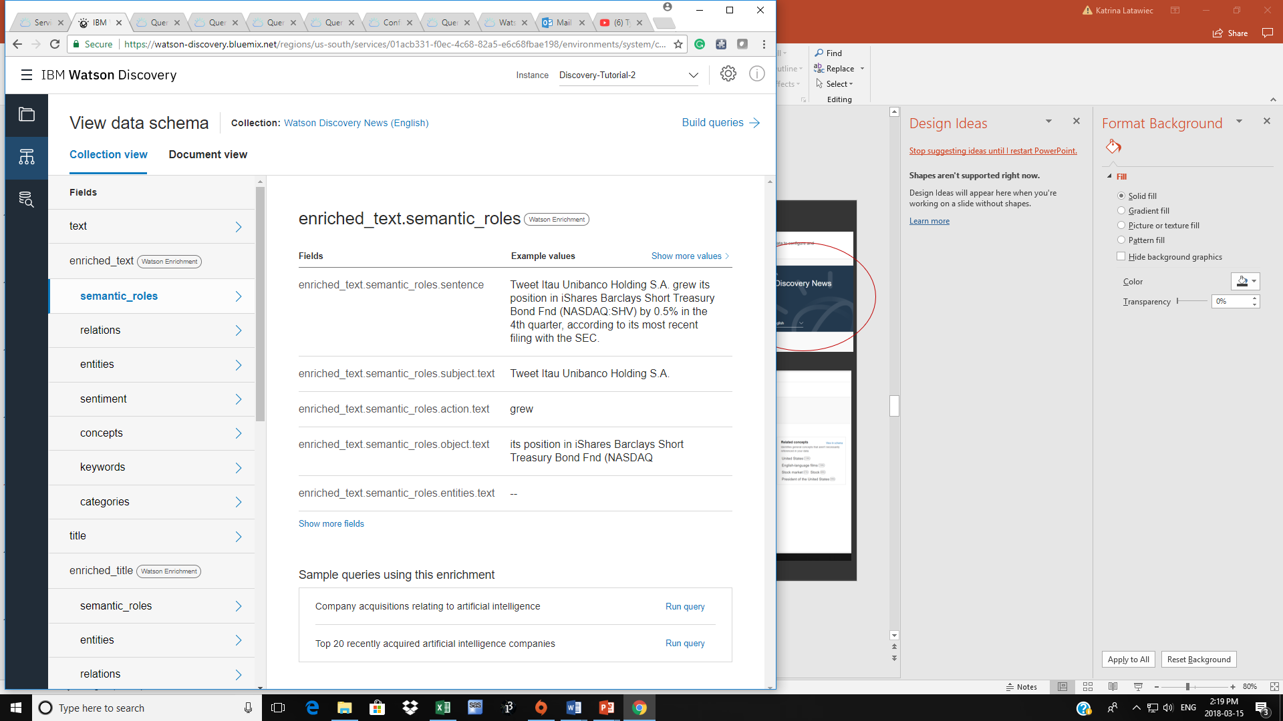
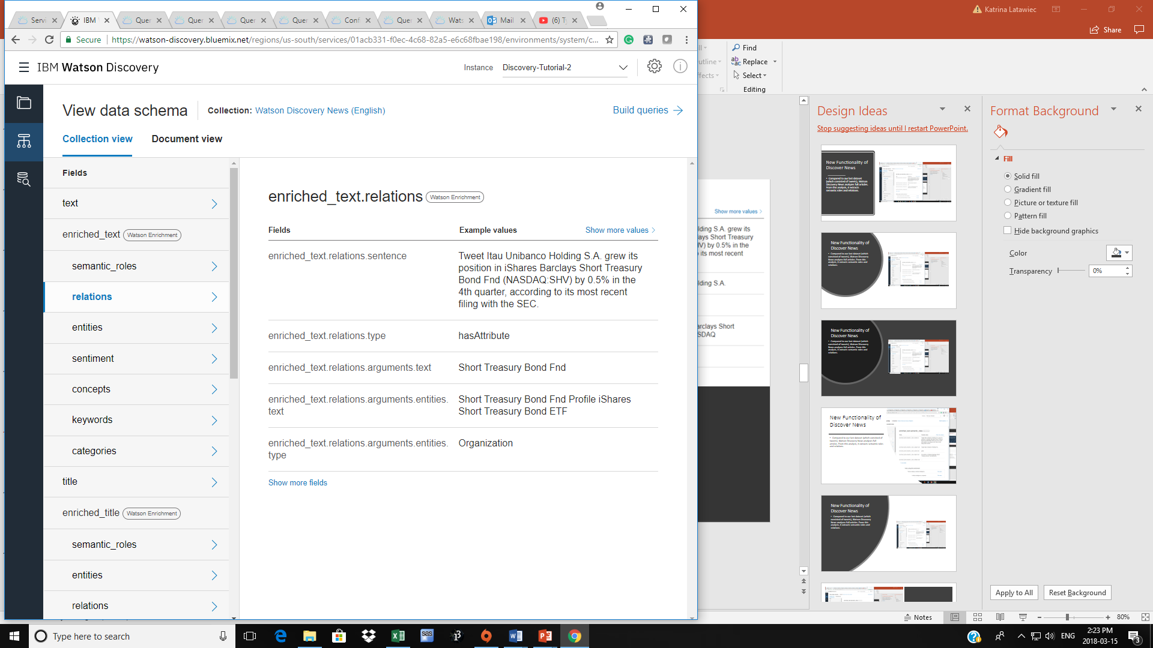
New Functionality of Discover News
Compared to our last dataset which used the default configurations, Watson Discovery News uses a custom configuration and extracts semantic roles and relations for its documents. For more information on setting up custom discovery configurations:
https://console.bluemix.net/docs/services/discovery/custom-config.html
Semantic_Roles enrichment finds sentences like subjects, actions and objects within the ingested text.
Relations enrichment aims to extract relationship between known relationships between entities in text.

Slide 16
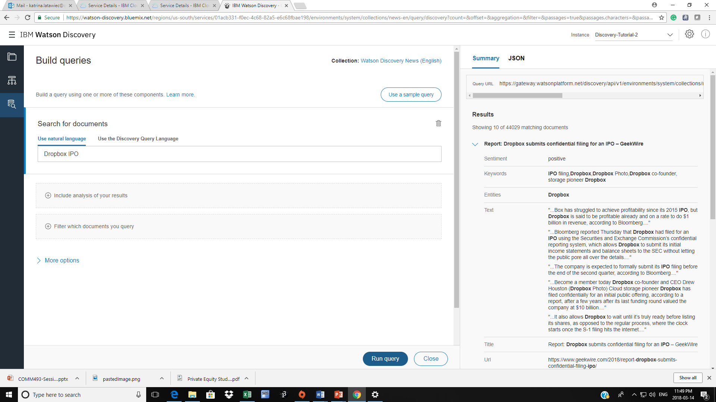
Querying News with the Visual Interface
Similarly to Part A, Discovery News can be queried with Natural Language. However, due to the large sample size, looking through all 44,029 would be a daunting task. But, as you may be wondering, there is a better way. This is one reason to use the Watson Visual Interface to extract more specific data from News.

Slide 17
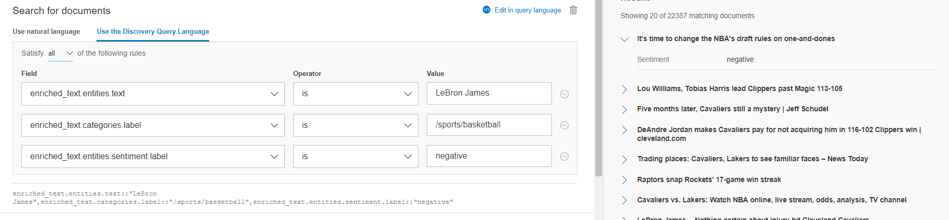
Querying News with the Visual Interface (2)
As pictured below, discovery allows us make queries visually, as long as we know the relevant field.
The query below searches for enriched text with the entity LeBron James, which has been relegated to the category /sports/basketball AND has a negative sentiment.

Slide 18
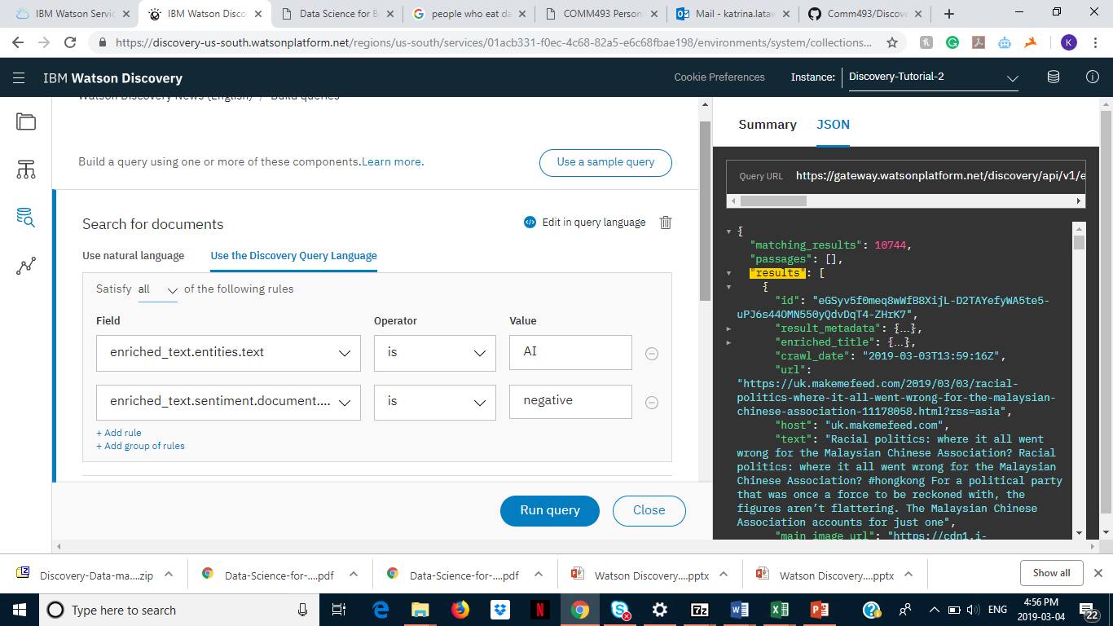
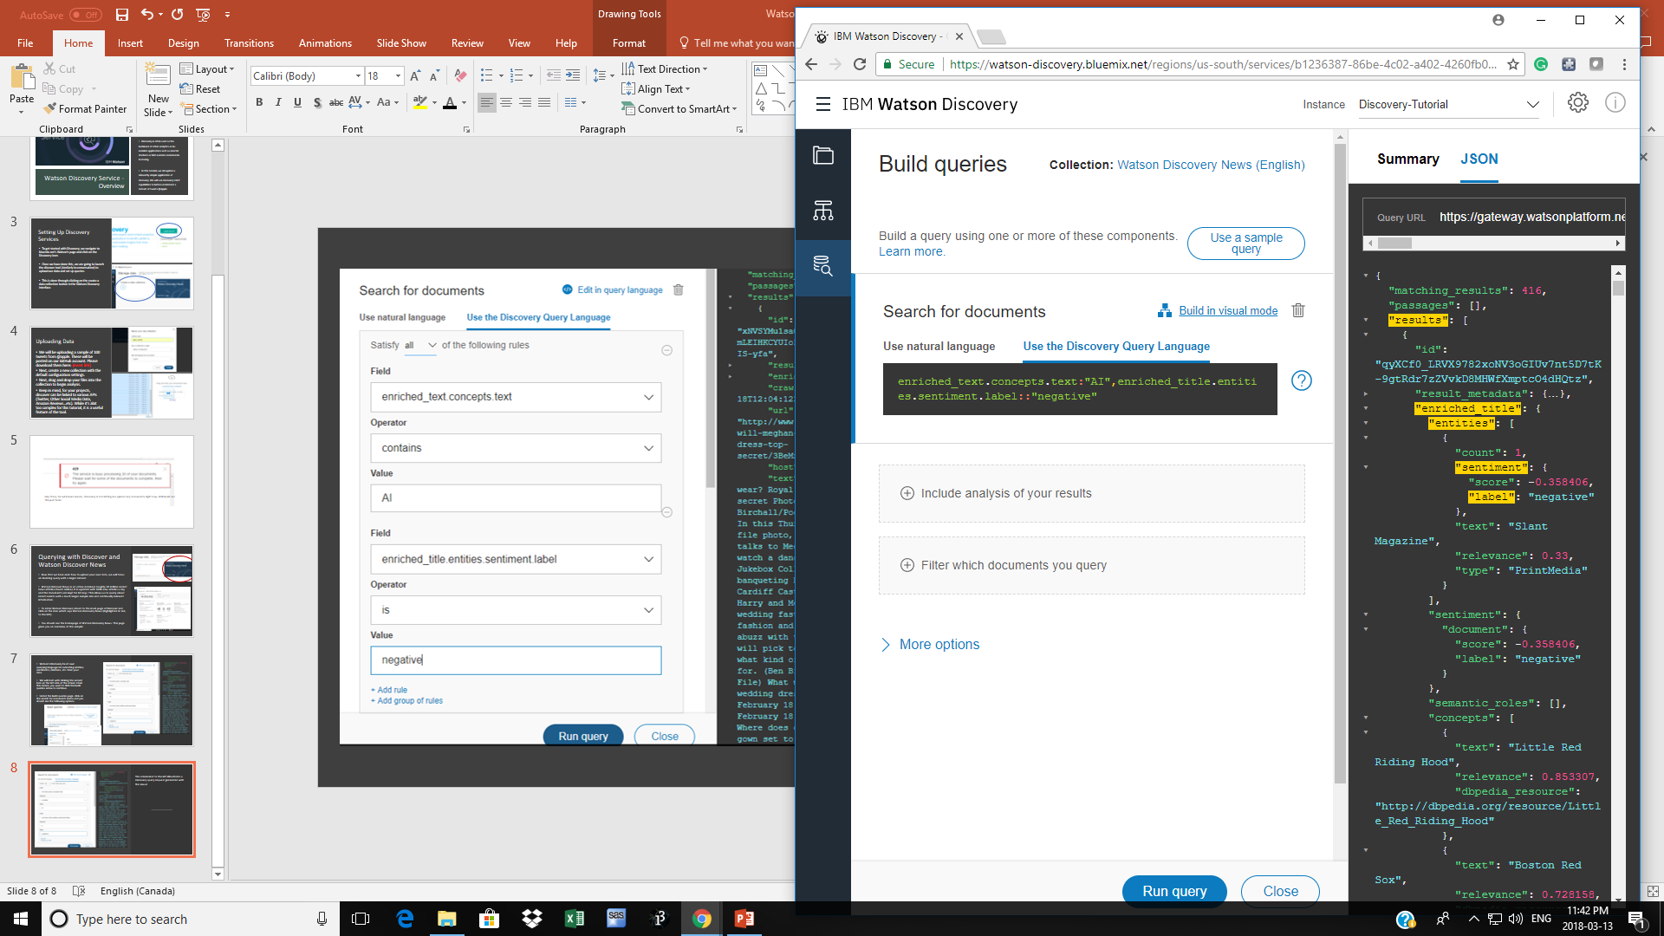
Visual Querying: Example
In addition to a description of matching documents, Watson Discovery also allows you to see the JSON output from your query (pictured to the left) as we have seen earlier.
The search to the left would find all text with extracted concepts related to “AI” with an overall negative sentiment label.
The screenshot below is the same query done through querying language.
Speaking of the discovery querying language…

Slide 19
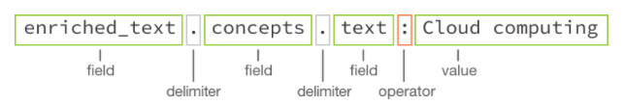
Building Queries with Watson Querying Language
While the visual querying is great for using within the Discovery interface, if we want to pass queries to or from your application, we will need to use the Watson Querying Language.
Above is the basic structure of a Watson Query, as we have seen before in our various examples. Each field is separated by a delimiter which distinguishes between various levels of hierarchy within a JSON schema. This query would find concepts within our text with CONTAIN the value of “Cloud Computing”.

Slide 20
Queries and Operators
Similarly to other languages, Watson Discovery Querying Language uses the standard operators like numerical comparisons (>,<, >=, <=), extract match (::, ::!), includes (:, :!) as well as unique operators including:
Boolean operators for OR ( this | that ) as well as AND ( this, that).
Nest Groups:
Enriched_text.entities:(text: “SpaceX, type: Company)
\ for Escape Characters:
Title::”Marie Antoinette said “/ Qu’ils mangent de la brioche”/”
For more information on the structure of Operators: https://console.bluemix.net/docs/services/discovery/query-operators.html#query-operators

Slide 21
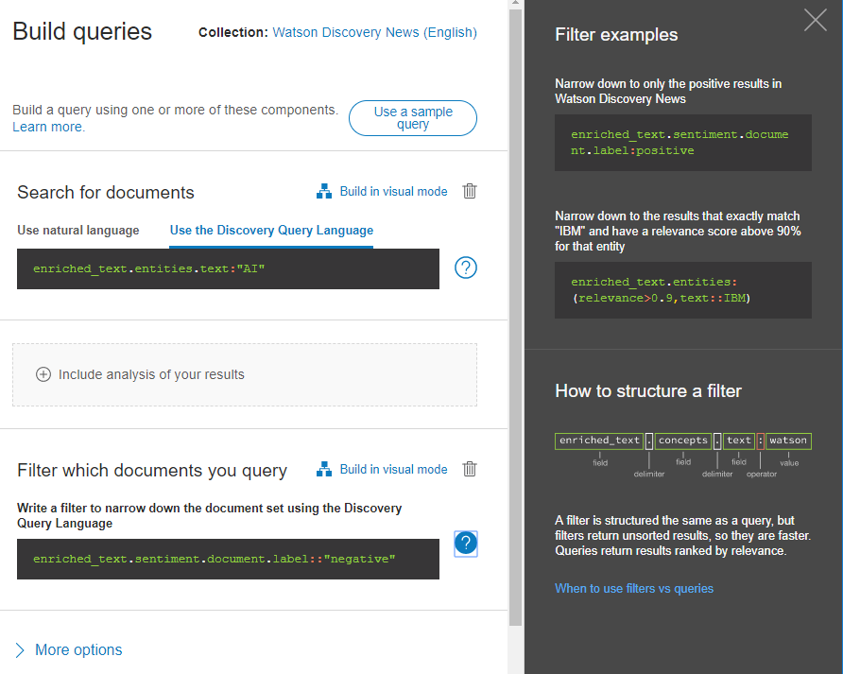
Building Queries & Filters
Up until now, queries and filters may have seemed similar as they produce almost the same results on a small dataset.
However, on larger datasets, queries and filters can be used together to strength results.
The fundamental difference between the two is that queries provide ranked results while filter return results in no specific order.
On larger datasets, it is useful to run both the results will be ranked in order of relevance and filtered to remove results which are not desired. To the right is an example of a query with a filter.

Slide 22
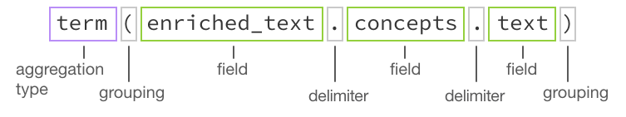
Aggregation
While we can make our queries and filter ever more specific to narrow results, there are incidents were we simple want the top 25 results from a given query.
This is achieved through aggregations.
Above is the structure of a query in the Discovery querying language. Terms for aggregation may be specific terms or filters as well as top results, a time period, interval-based (e.g. histogram), average, sum, etc.
For more information on Aggregations:
https://console.bluemix.net/docs/services/discovery/query-reference.html#aggregations

Slide 23
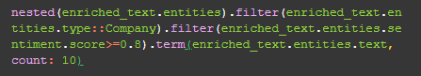
Nested Aggregation
Another feature of aggregation is the ability to nest parts of your query in an aggregation without aggregating the whole query.
Applying a nested before an aggregation query restricts the aggregation to the area specified. For example, the following:
nested(enriched_text.entities)
Means that only the enrich_text.entities components of the results will be used to aggregate against.
For example: the following would be a query to find the top 10 companies with the most positive sentiment. Note that the nested aggregation narrows the results to enriched_text.entities then two filters are applied to find entities with the type “Company” and which have a sentiment score above >=0.8 and finally aggregates again to the top 10 most relevant results.

Slide 24
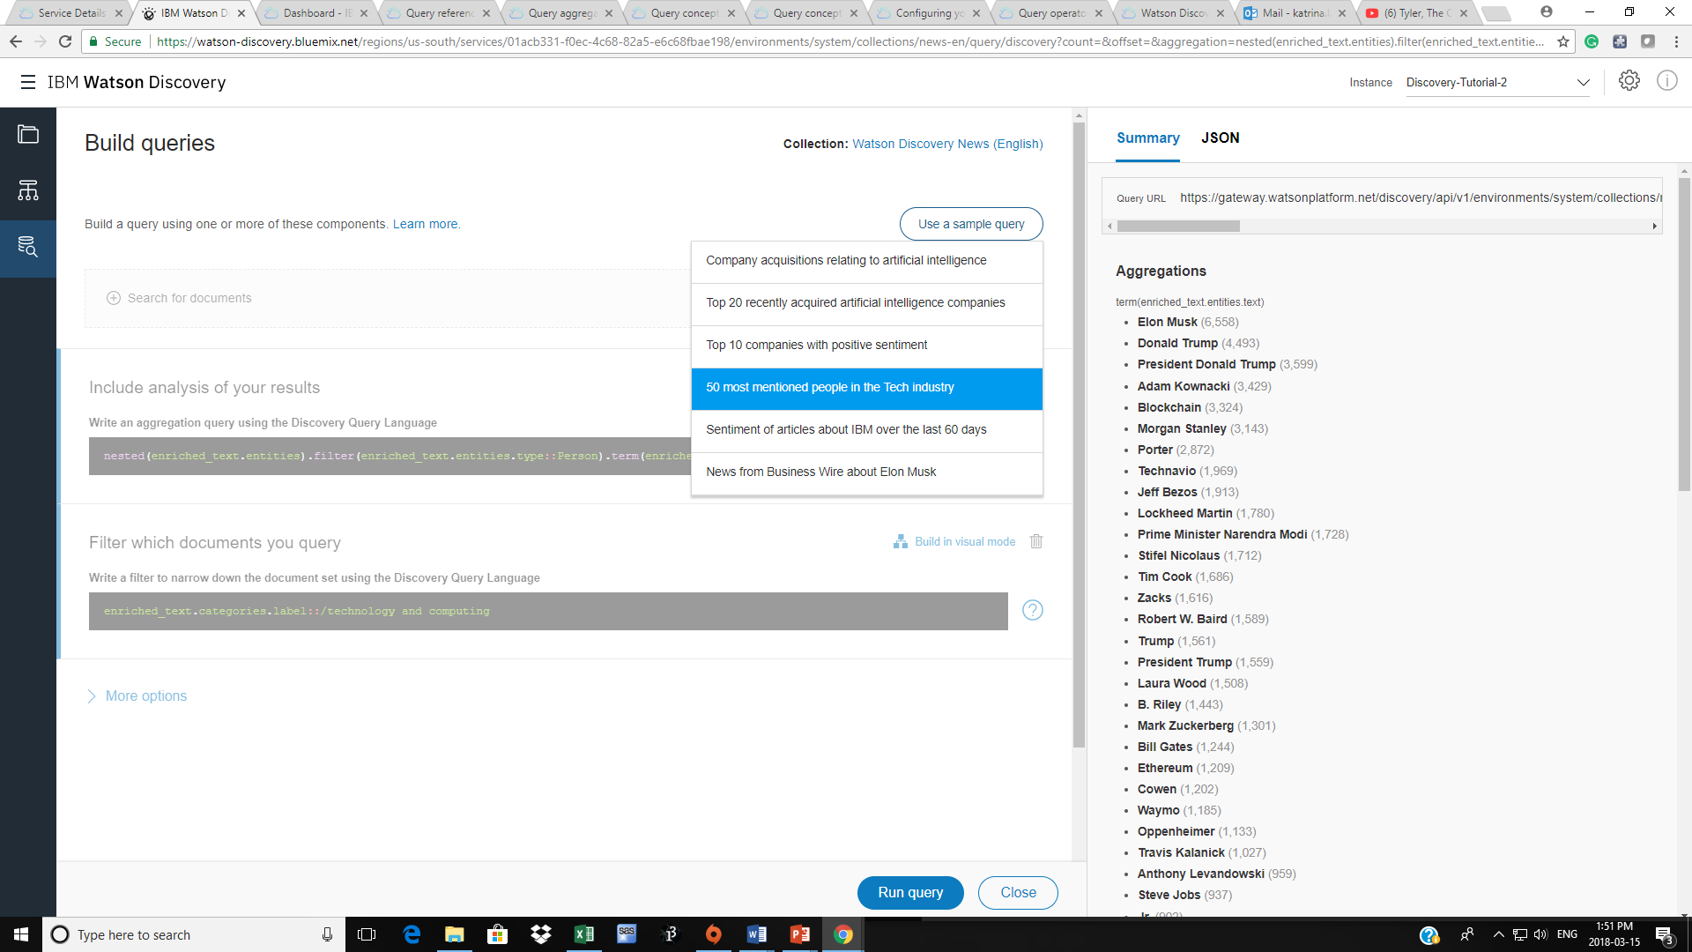
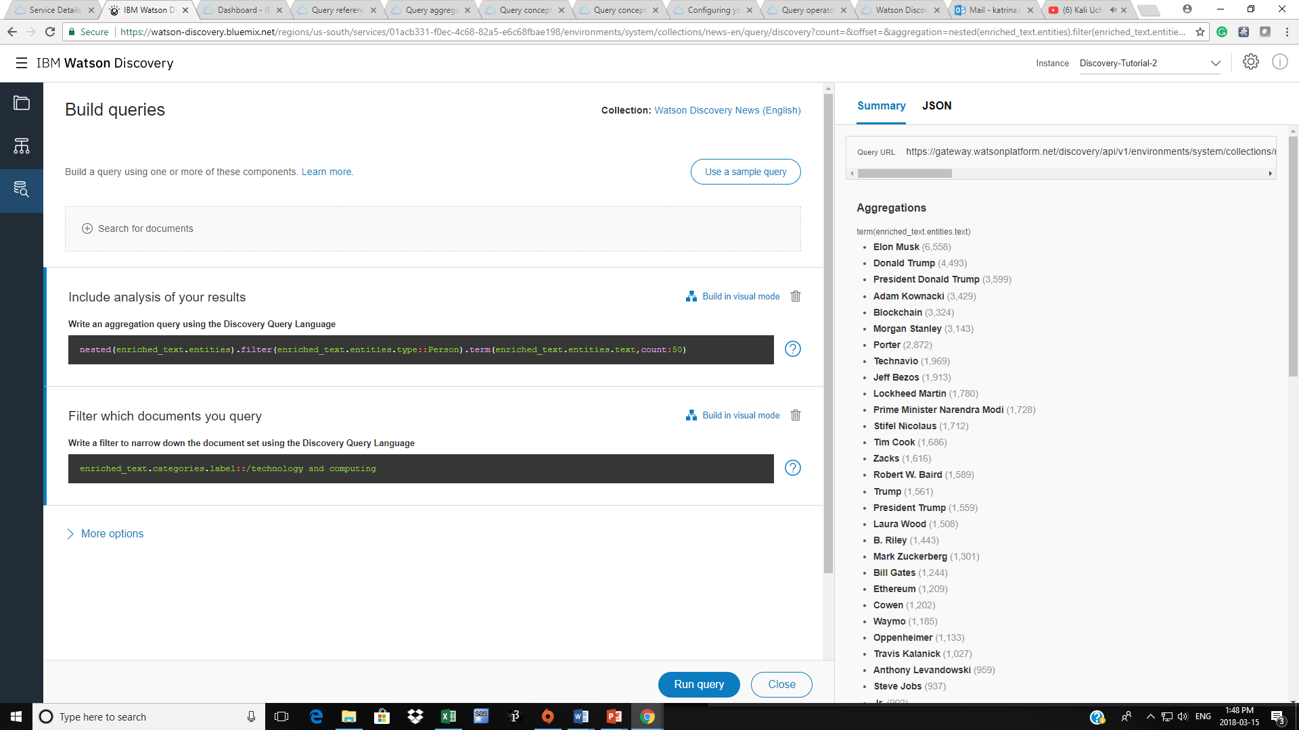
Aggregation Example
This is example of using both aggregation and a filter to find the 50 most mentioned persons within the tech industry.

Slide 25
Deliverable B:
For your next assignment,
Use Watson Discovery querying language to find the top 20 most talked about people in basketball in recent news WITH a sentiment score of >=0.5.
Add a screenshot of your results as well as your query request.

